Slide 1
CPR
Emergency First Aid
Provide First Aid
Education and Care First Aid
Asthma & Anaphylaxis
January 2019

Slide 2
CPR – half day
CPR– 2 hours (with pre-work)
CPR with Asthma and Anaphylaxis

Slide 3
Emergency First Aid – one day
Emergency First Aid with Asthma and Anaphylaxis

Slide 4
Provide First Aid – two days
Provide First Aid – one day
Provide First Aid with Asthma and Anaphylaxis – two days
Provide First Aid with Asthma and Anaphylaxis – one day

Slide 5
Education and Care First Aid two days
Education and Care First Aid – one day (with pre-work)
Education and Care First Aid with Asthma and Anaphylaxis – two days
Education and Care First Aid with Asthma and Anaphylaxis – one day (with pre-work)

Slide 6
Asthma and Anaphylaxis
Asthma
Anaphylaxis

Slide 7
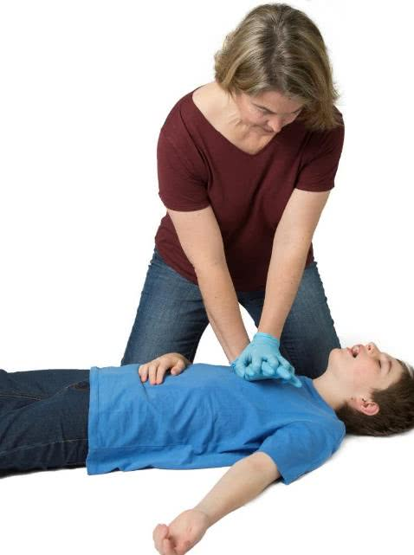
CPR – Half day
Topics
Introduction
Legal Issues
Infection Control
DRSABCD action plan
Unconscious breathing
Resuscitation
Defibrillation
Choking

Slide 8
CPR – Two hours (with pre-work)
Topics
Introduction
DRSABCD
Choking

Slide 9
CPR with Asthma and Anaphylaxis – One day
Topics
Introduction
Legal Issues
Infection Control
DRSABCD action plan
Unconscious breathing
Resuscitation
Defibrillation
Choking
Asthma
Anaphylaxis
Medical Management Plans

Slide 10
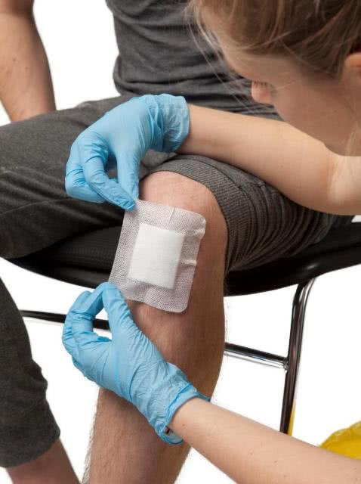
Emergency First Aid – One day
Topics
Introduction
Legal Issues
Infection Control
DRSABCD action plan
Unconscious breathing
Resuscitation
Defibrillation
Choking
First aid kits
Chest pain
Stroke
Asthma
Anaphylaxis
Shock
Wounds and Bleeding
Burns

Slide 11
Emergency First Aid with Asthma and Anaphylaxis – 1.5 day
Topics
Introduction
Legal Issues
Infection Control
DRSABCD action plan
Unconscious breathing
Resuscitation
Defibrillation
Choking
Asthma
Anaphylaxis
Medical Management Plans
First aid kits
Chest pain
Stroke
Shock
Wounds and Bleeding
Burns

Slide 12
Provide First Aid – Two Days
Day One Topics
Introduction
Legal Issues
Infection Control
DRSABCD action plan
Unconscious breathing
Resuscitation
Defibrillation
Choking
First aid kits
Chest pain
Stroke
Asthma
Anaphylaxis
Shock
Wounds and Bleeding
Burns
Day Two Topics
Safety and Risk Management
Fractures, sprains, strains, dislocations
Head, neck and spinal injuries
Chest and abdominal injuries
Facial and eye injuries
Heat and Cold
Poisons
Bites and Stings
Other medical emergencies

Slide 13
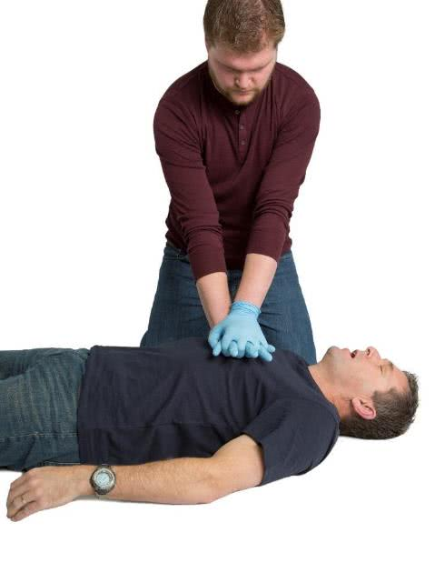
Provide First Aid – One Day (with pre-work)
Topics
Introduction
DRSABCD
Wounds and Bleeding
Choking
Asthma
Anaphylaxis
Fractures, sprains, strains
Bites and Stings

Slide 14
Provide First Aid with Asthma and Anaphylaxis – Two Days
Day One Topics
Introduction
Legal Issues
Infection Control
DRSABCD action plan
Unconscious breathing
Resuscitation
Defibrillation
Choking
Asthma
Anaphylaxis
Medical Management plans
First aid kits
Chest pain
Stroke
Shock
Wounds and Bleeding
Day Two Topics
Burns
Safety and Risk Management
Fractures, sprains, strains, dislocations
Head, neck and spinal injuries
Chest and abdominal injuries
Facial and eye injuries
Heat and Cold
Poisons
Bites and Stings
Other medical emergencies

Slide 15
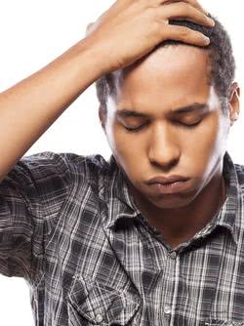
Provide First Aid with Asthma and Anaphylaxis
– One Day (with pre-work)
Topics
Introduction
DRSABCD
Wounds and Bleeding
Choking
Asthma
Anaphylaxis
Medical Management Plans
Fractures, sprains, strains
Bites and Stings

Slide 16
Education and Care First Aid – Two Days
Day One Topics
Introduction
Legal Issues
Infection Control
DRSABCD action plan
Unconscious breathing
Resuscitation
Defibrillation
Choking
First aid kits
Chest pain
Stroke
Asthma
Anaphylaxis
Shock
Wounds and Bleeding
Burns
Day Two Topics
Safety and Risk Management
Fractures, sprains, strains, dislocations
Head, neck and spinal injuries
Chest and abdominal injuries
Facial and eye injuries
Heat and Cold
Poisons
Bites and Stings
Other medical emergencies

Slide 17
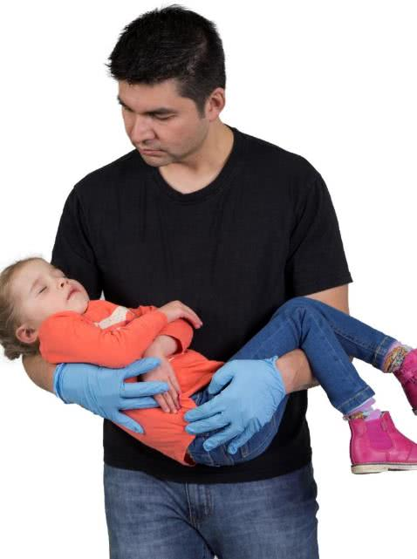
Education and Care First Aid – One Day (with pre-work)
Topics
Introduction
DRSABCD
Wounds and Bleeding
Choking
Asthma
Anaphylaxis
Fractures, sprains, strains
Bites and Stings

Slide 18
Education and Care First Aid with Asthma and Anaphylaxis – Two Days
Day One Topics
Introduction
Legal Issues
Infection Control
DRSABCD action plan
Unconscious breathing
Resuscitation
Defibrillation
Choking
Asthma
Anaphylaxis
Medical Management Plans
First aid kits
Chest pain
Stroke
Shock
Wounds and Bleeding
Day Two Topics
Burns
Safety and Risk Management
Fractures, sprains, strains, dislocations
Head, neck and spinal injuries
Chest and abdominal injuries
Facial and eye injuries
Heat and Cold
Poisons
Bites and Stings
Other medical emergencies

Slide 19
Education and Care First Aid with Asthma and Anaphylaxis
– One Day (with pre-work)
Topics
Introduction
DRSABCD
Wounds and Bleeding
Choking
Asthma
Anaphylaxis
Medical Management Plans
Fractures, sprains, strains
Bites and Stings

Slide 20
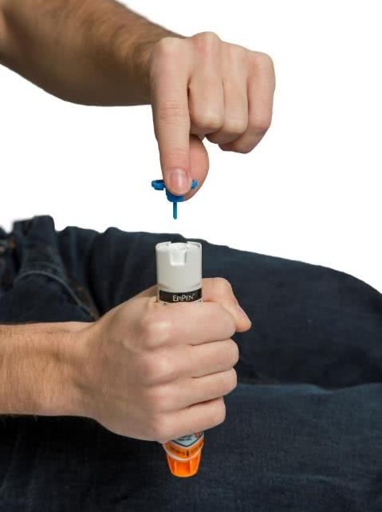
Asthma and Anaphylaxis
Topics
Introduction
Legal Issues
DRSABCD action plan
Asthma
Anaphylaxis
Medical Management Plan

Slide 21
Anaphylaxis
Topics
Introduction
Legal Issues
DRSABCD action plan
Anaphylaxis
Medical Management Plan

Slide 22
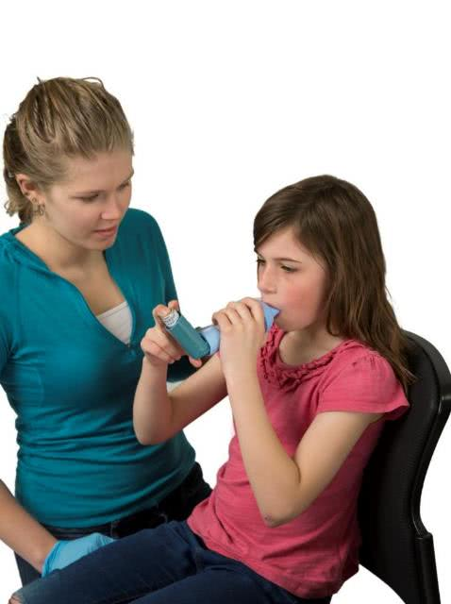
Asthma
Topics
Introduction
Legal Issues
DRSABCD action plan
Asthma
Medical Management Plan

Slide 23

Introduction / 1 / Course information
Housekeeping
Course content
Organisation policy and procedures
WHS
Access and equity
Assessment requirements
Introductions

Slide 24
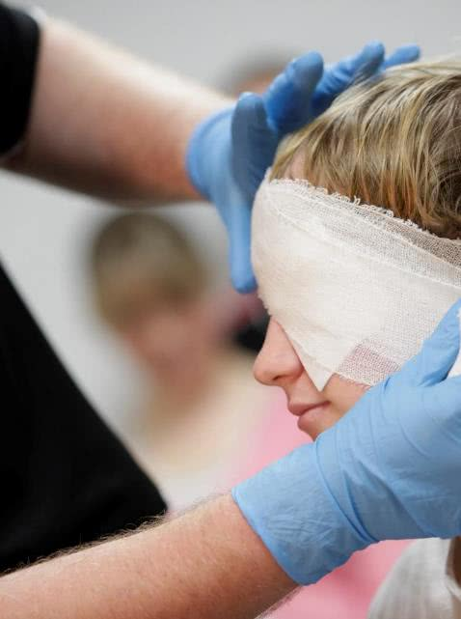
Introduction / 2 / First aid
‘Initial care provided for an acute illness or injury.’
  Casualty:
  Signs
  Symptoms
  Aims:
  a safe environment
  preserve life
  alleviate suffering
  prevent from getting worse
  help promote recovery

Slide 25

Legal issues / 1 / Introduction
Duty of care
Consent
Documentation

Slide 26
Legal issues / 2 / Duty of care
Applies where one person owes a duty to another person.
Once you commence first aid, you have a duty of care.

Slide 27

Legal issues / 3 / Consent
Obtain consent: implied or expressed.
Casualty under 18 years: consent of a parent/legal guardian.
Unconscious casualty: necessity.
If consent is refused, you may be charged with assault if you proceed to provide first aid.

Slide 28
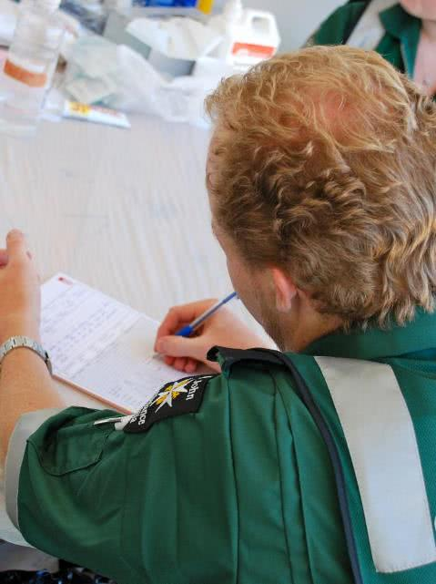
Legal issues / 4 / Document recording
Record details of any treatment.
May be used as evidence in court.
Record in ink, not pencil.
Record facts not opinion.
Sign and date the record.
Maintain confidentiality.
Store in a secure locked cabinet.

Slide 29
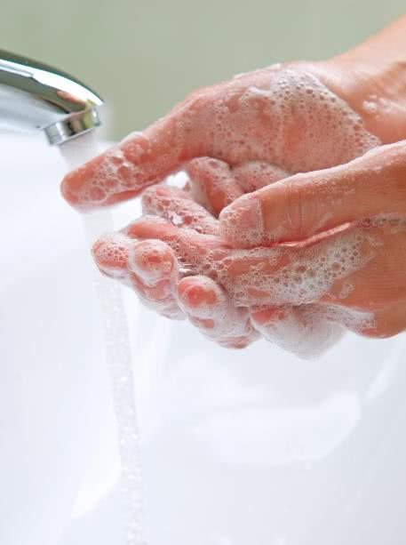
Infection control / 1 / Introduction
Infectious diseases
Transmission of infectious diseases
Protect yourself and your casualty
Protective methods
Protective devices

Slide 30
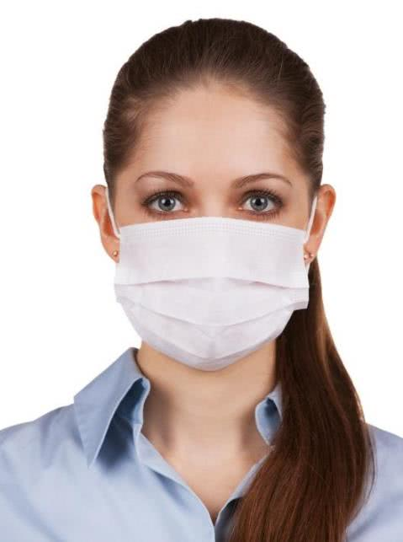
Infection control / 2 / Infectious diseases
What are infectious diseases?
May be passed on via:
  blood and other body fluids.
  infected needles or sharp objects.
  Always take precautions.

Slide 31
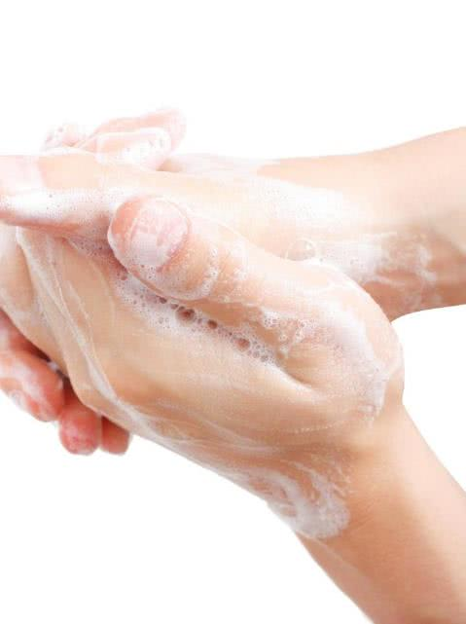
Infection control / 3 / Before first aid
Wash hands
Cover exposed cuts
Wear disposable gloves
Face mask, eye protection

Slide 32
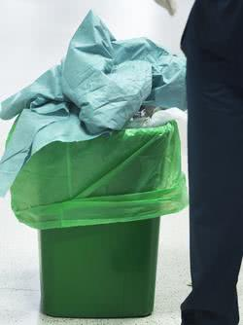
Infection control / 4 / After first aid
Disinfect/wash:
  blood splashed clothing
  contaminated surfaces
  equipment
Dispose waste carefully
Wash hands

Slide 33
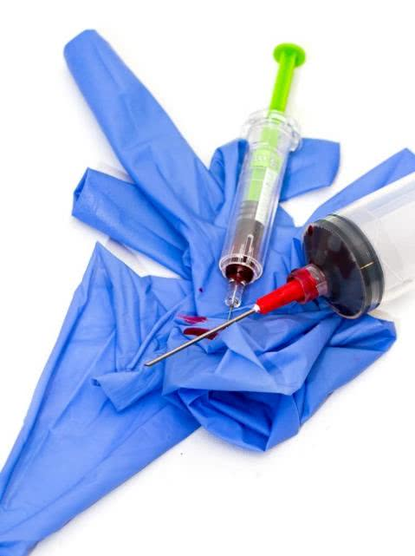
Infection control / 5 / Blood & needle stick accidents
If skin is involved:
  Wash with soap and water
  No water - use hand wipes and alcohol gel
If mouth involved:
  Spit contaminant out and rinse
If eyes involved:
  Irrigate eyes for at least 5 minutes, keeping eyes open
Refer to health care provider e.g. GP

Slide 34
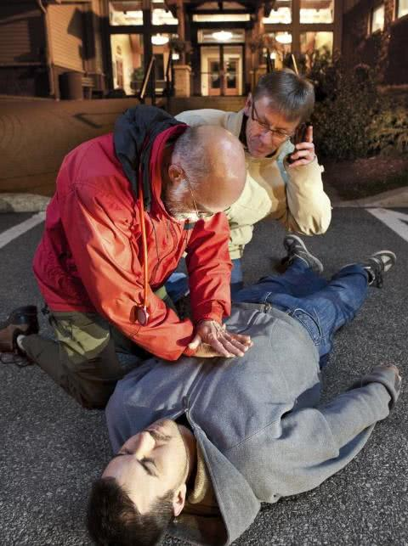
DRSABCD / 1 / Introduction
Basic life support
DRSABCD action plan
Calling emergency services
Casualty handover
Documentation
Stress management

Slide 35
DRSABCD / 2 / St John action plan
D
Danger
R
Response
S
Send for help
A
Airway
B
Breathing
C
CPR
D
Defibrillation

Slide 36
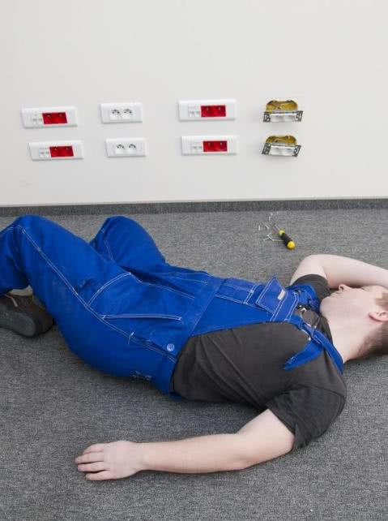
DRSABCD / 3 / Danger
Danger
To you
To others
To the patient

Slide 37
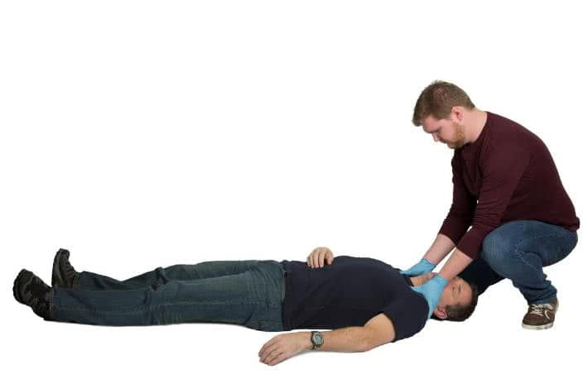
DRSABCD / 4 / Response
Response
Is the casualty conscious?
“What is your name?”
Squeeze the casualty's shoulders

Slide 38
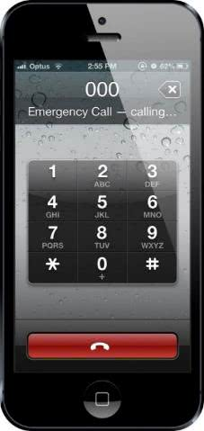
DRSABCD / 5 / Send for help
Send for help
000
  Your telephone number
  name
  service required
  city
Emergency Services
  Address
  Telephone number
  Name: caller and casualty
  Number of casualties and complaint
  Is patient conscious?
  Is patient breathing?

Slide 39

DRSABCD / 6 / Send for help
Remember
  Calm and speak clearly
  Answer all questions
  Obey instructions
  Estimated time of arrival of medical aid
  Do NOT hang up the phone until directed

Slide 40
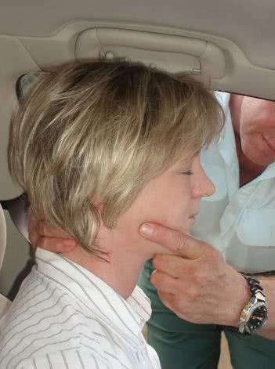
DRSABCD / 7 / Airway
Airway
Is it clear?
Open the airway

Slide 41
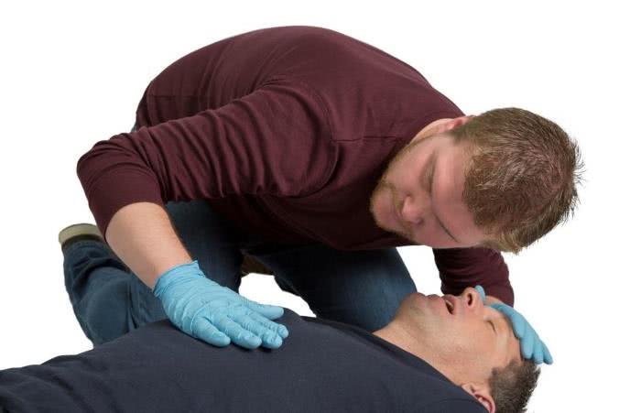
DRSABCD / 8 / Breathing
  Look, listen, feel
  Breathing -> Recovery Position
  Not Breathing -> CPR

Slide 42
DRSABCD / 9 / CPR
CPR
30 chest compressions
2 breaths

Slide 43
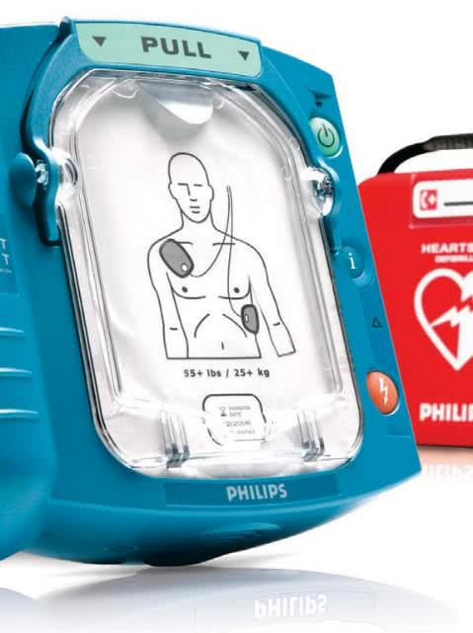
DRSABCD / 10 / Defibrillation
Defibrillation
Unconscious, not breathing
Re-establish heart rhythm

Slide 44
DRSABCD / 11 / St John action plan
D
Danger
R
Response
S
Send for help
A
Airway
B
Breathing
C
CPR
D
Defibrillation

Slide 45
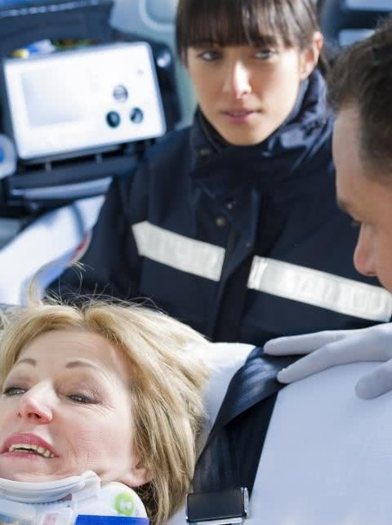
DRSABCD / 12 / Handover
At a handover give:
casualty’s name, if known
age
patient's signs & symptoms
history
management given
progress in your care
any other information

Slide 46
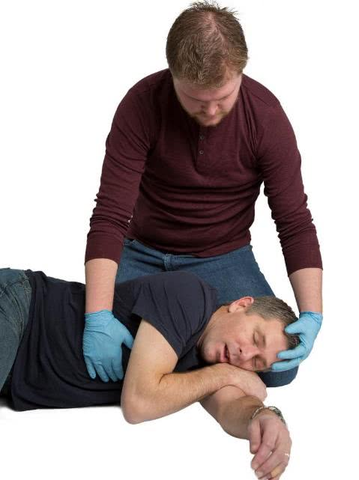
Unconscious breathing / 1 / Introduction
D
Danger
R
Response
S
Send for help
A
Airway
B
Breathing
Recovery position
Head to toe assessment
July 2018

Slide 47
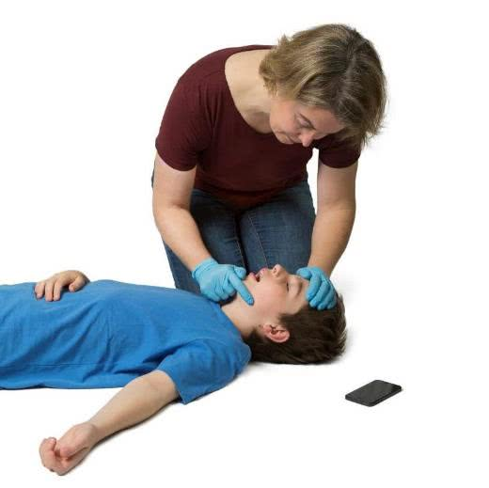
Unconscious breathing / 2 / Airway
Check whilst on back.
If there is no foreign material, open the airway.
Asphyxia is where the airway is compromised.

Slide 48
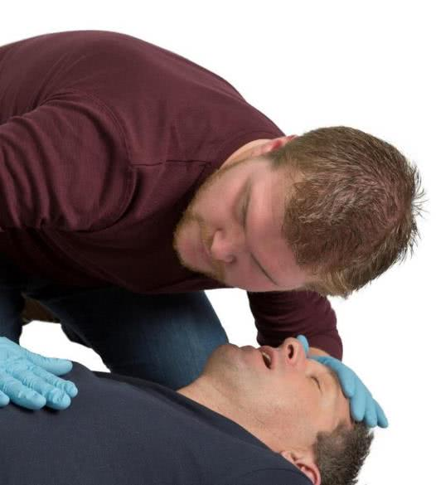
Unconscious breathing / 3 / Breathing
Look
Listen
Feel
For about 10 seconds
An occasional gasping breath is not adequate breathing!

Slide 49
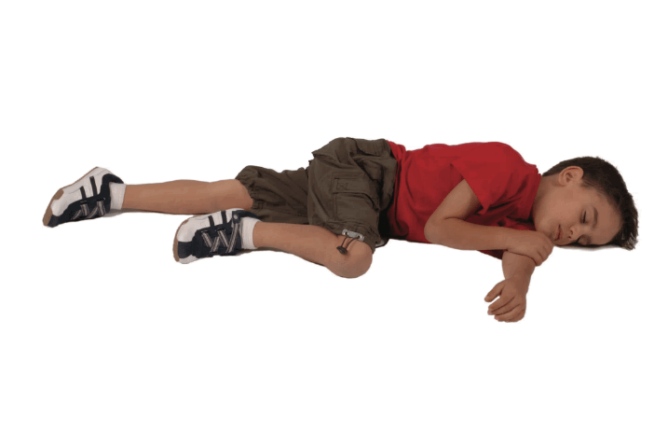
Unconscious breathing / 4 / Recovery position

Slide 50
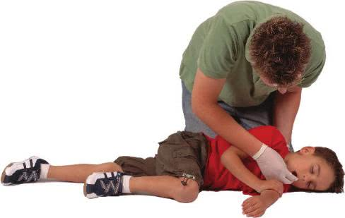
Unconscious breathing / 5 / Airway
If the airway is obstructed with fluid or loose material;
  Turn casualty on side
  Tilt head back
  Open mouth
  Clear airway

Slide 51
Unconscious breathing / 6 / Airway
In car accidents it is important to open the airway by tilting head back.

Slide 52
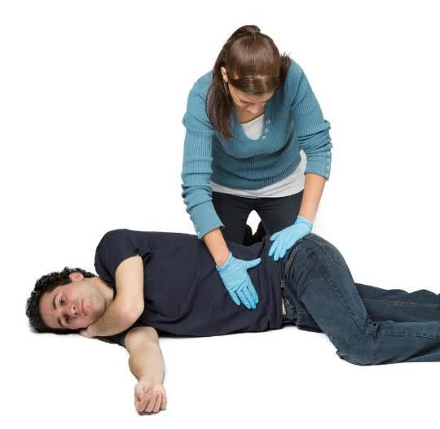
Unconscious breathing / 7 / Head to toe assessment
Examine head
Check face
Check neck
Check shoulders, arms & hands
Check chest
Check abdomen
Check pelvis and buttocks
Check legs, ankles and feet
Record any movement and feeling in limbs
Check for any medic-alerts

Slide 53
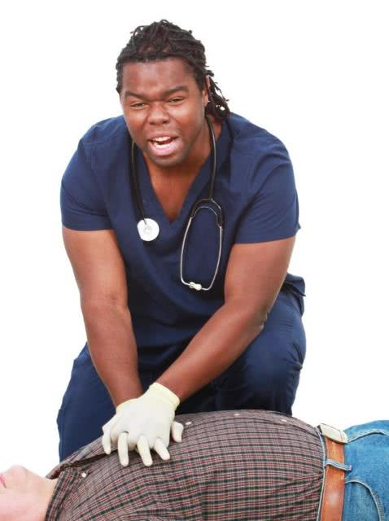
CPR / 1 / Introduction
CPR on an adult, child and infant
  30 compressions : 2 breaths
Breaths
  Mouth to mouth
  Mouth to nose
  Mouth to mask

Slide 54
CPR / 2 / St John action plan
D
Danger
R
Response
S
Send for help
A
Airway
B
Breathing
C
CPR
Unconscious, non-breathing casualty
D
Defibrillation

Slide 55
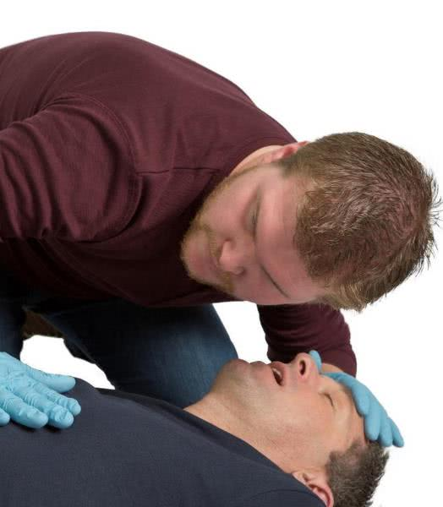
CPR / 3 / Breathing
Look
Listen
Feel
If not breathing normally start CPR
An occasional gasping breath is not adequate breathing!

Slide 56
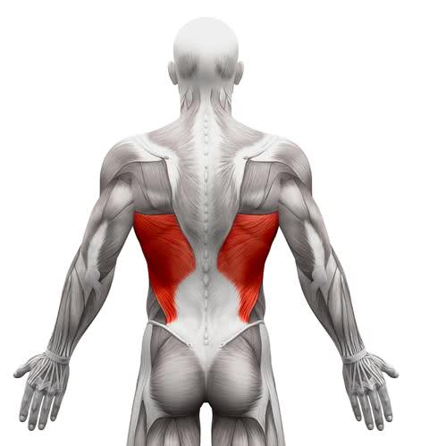
CPR/ 4 / Anatomy and physiology
Three body systems:
Respiratory system
Circulatory system
Nervous system
CPR achieves this by:
  Chest compressions and
  breathing into the casualty’s lungs.

Slide 57
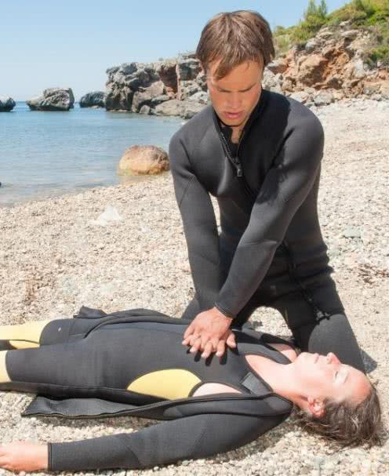
CPR / 5 / Cardiopulmonary resuscitation
Commence CPR
30 compressions : 2 breaths
at a rate of 100-120 compressions per minute

Slide 58
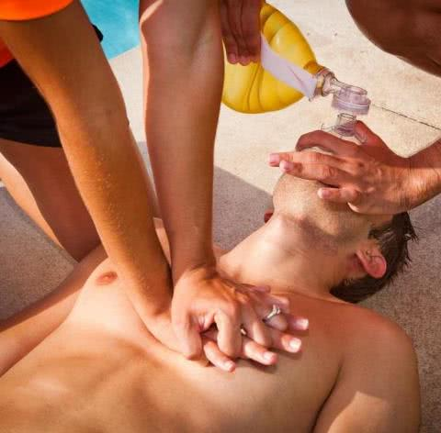
CPR / 6 / Compressions
Lower half of the breastbone in the centre of the chest.
Compress about one third (1/3) the depth of the chest.

Slide 59
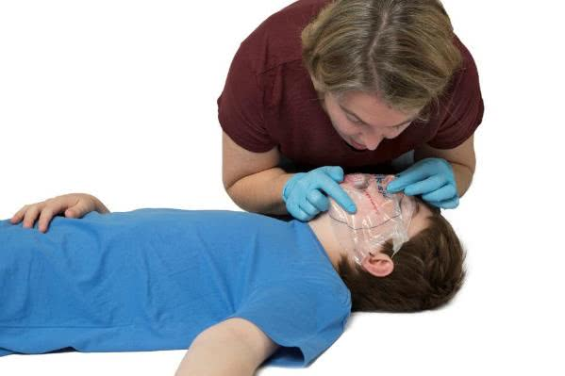
CPR / 7 / Breaths
Tilt the head back, lift the chin.
Blow into casualty's mouth.
Blow a second (2nd) breath and watch for chest to rise and fall.
Unable or unwilling to give mouth to mouth?
      give compressions only.

Slide 60
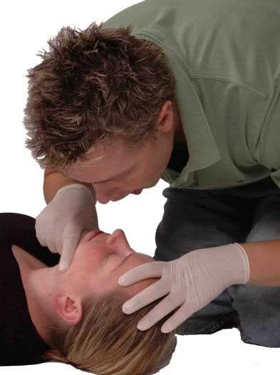
CPR / 8 / Breaths – mouth to nose
Used when
Jaw and/or teeth are broken.
Jaw is tightly clenched.

Slide 61
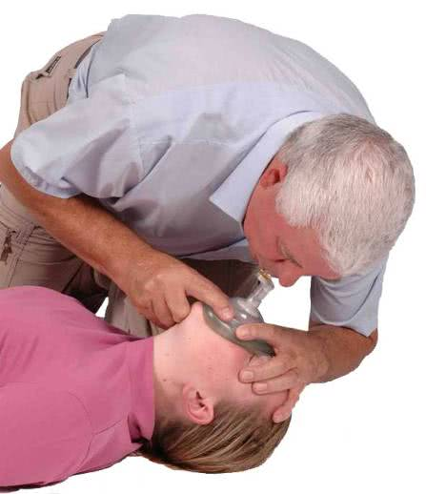
CPR / 9 / Breaths – mouth to mask
Avoids mouth-to-mouth contact.
Do not delay to get a mask.

Slide 62

CPR / 10 / Drowning
Drowning – breathing difficulties from immersion in liquid.
Never attempt a rescue beyond your swimming ability.
Every second is vital!
Call triple zero (000).

Slide 63
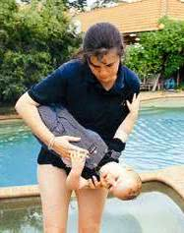
CPR / 11 / Drowning
Management
  DRSABCD

Slide 64
CPR / 12 / Remember
  Any attempt at resuscitation is better than no resuscitation
  Australian Resuscitation Council

Slide 65
Defibrillation / 1 / Introduction
Chain of Survival
AED = Automated External Defibrillator
Describe an AED
How to use an AED

Slide 66
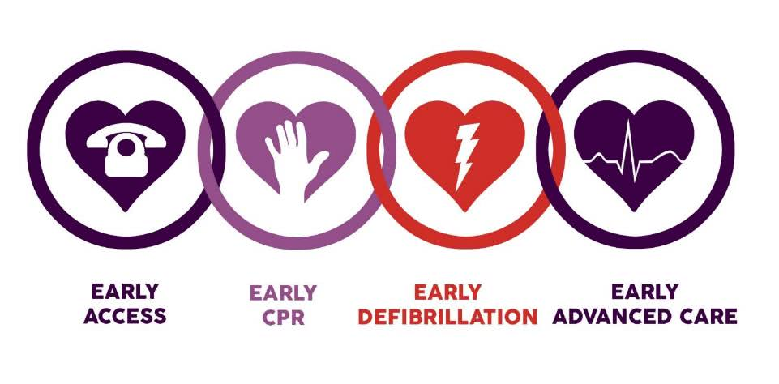
Defibrillation / 2 / The chain of survival

Slide 67
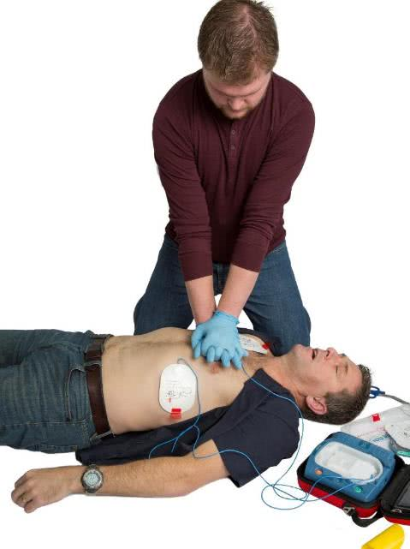
Defibrillation / 3 / Defibrillation
Sudden cardiac arrest.
Help re-establish normality in a heart having irregular rhythms.
Defibrillator:
  Attach it.
  Follow the machine prompts.

Slide 68
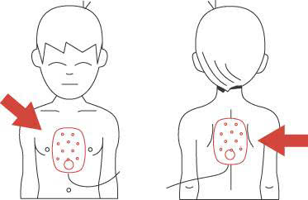
Defibrillation / 4 / Under the age of 8 or 25kg
Use paediatric pads
Position one pad in the middle of the chest
Place second pad on the back

Slide 69
Defibrillation / 5 / St John action plan
D
Danger
R
Response
S
Send for help
A
Airway
B
Breathing
C
CPR
D
Defibrillation

Slide 70
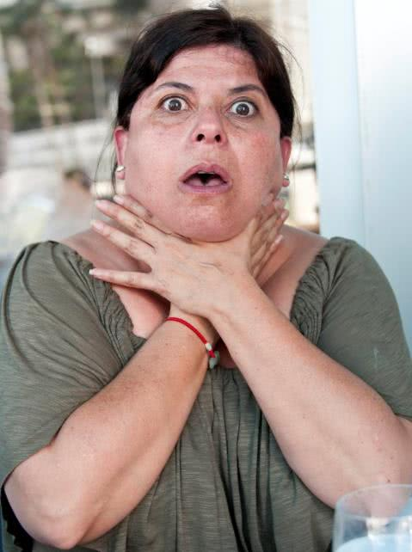
Choking / 1 / Introduction
Identify choking
Manage choking adult
Manage choking child

Slide 71
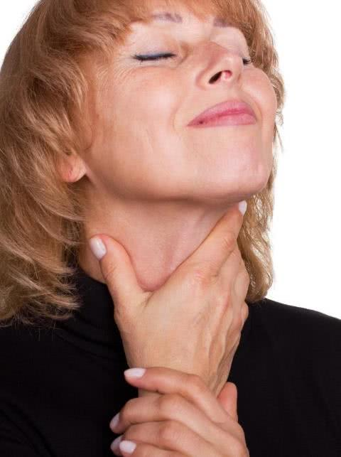
Choking / 2 / Signs and symptoms
Signs and symptoms include:
Clutching the throat
Coughing, wheezing, gagging
Difficulty breathing
‘Crowing’ noise
Blue in the face

Slide 72
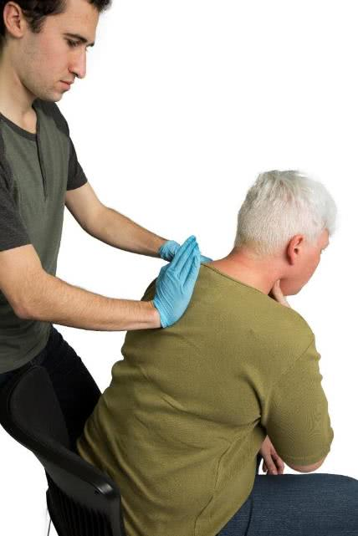
Choking / 3 / Management - adult
Get person to cough
Call triple zero (000)
DRSABCD
Up to 5 back blows
Up to 5 chest thrusts
Repeat

Slide 73
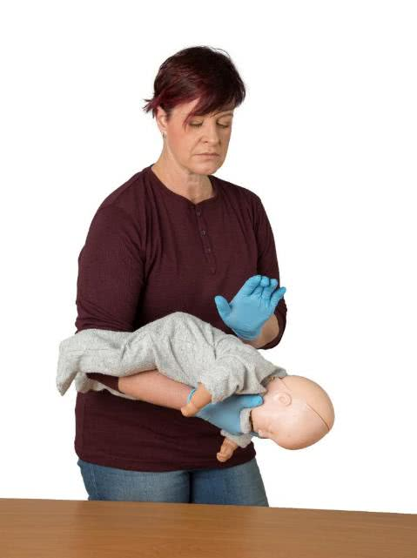
Choking / 4 / Management - infant
Call triple zero (000)
DRSABCD
Up to 5 back blows
Up to 5 chest thrusts
Repeat

Slide 74
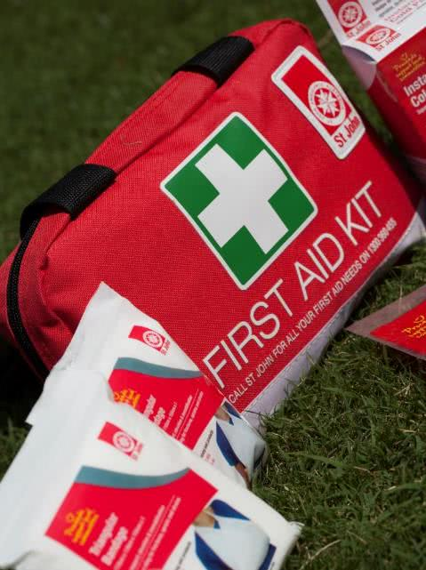
First aid kits / Introduction
Home, car and workplace.
Required by legislation in workplaces.
Regularly check:
  Contents are clean.
  Contents in sealed packets.
  Expiry dates not exceeded.
  Used items are replaced.
January 2018

Slide 75
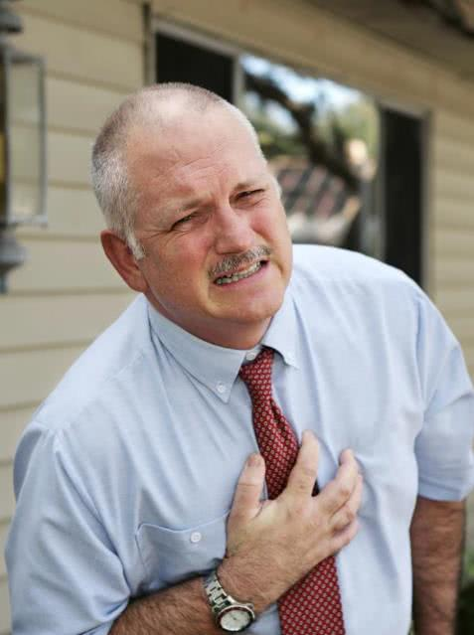
Chest pain / 1 / Introduction
Describe the causes of chest pain.
Manage a casualty with chest pain.

Slide 76
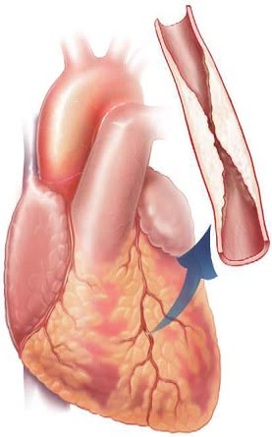
Chest pain / 2 / Cardiac causes of chest pain
Causes of chest pain include:
Angina – pain – low oxygen/narrowed arteries.
Heart Attack – no blood to heart muscle.

Slide 77
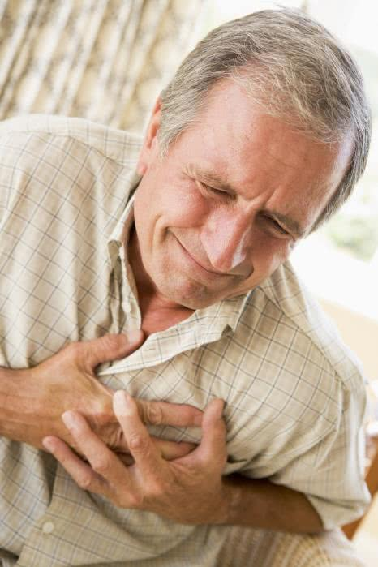
Chest pain / 3 / Signs and symptoms
Signs and symptoms include:
Pain in centre of the chest.
Pain can also be in the shoulders, back, neck and/or jaw.
Angina – typically only lasts minutes.

Slide 78
Chest pain / 4 / Management
Had it before
Stop and rest
Give angina medication
Repeat if symptoms not relieved in 5 minutes
If not relieved within 10 minutes, call triple zero (000) for an ambulance
300mg Aspirin*
Not had it before
Stop and rest
Call an ambulance
300mg Aspirin*
Monitor vital signs
Fetch AED if available
* Unless casualty is allergic to aspirin or their doctor has warned them against taking aspirin.

Slide 79
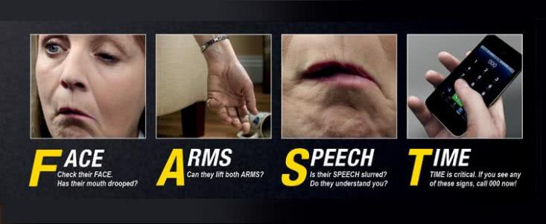
Stroke / 1 / Introduction
FACE ARMS SPEECH TIME
Image courtesy of the Stroke Foundation

Slide 80
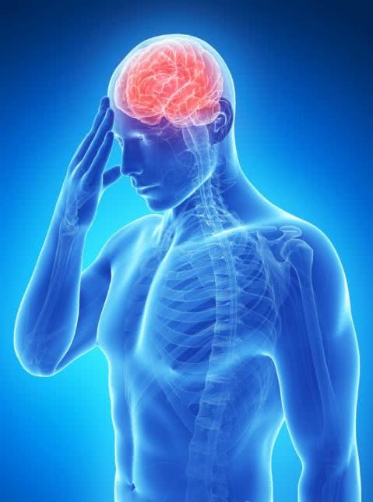
Stroke / 2 / Signs and symptoms
Signs and symptoms include:
Altered consciousness
Difficulty speaking
Weakness or paralysis
Numbness
Dizziness
Disturbed vision
Loss of balance
Confusion.

Slide 81

Stroke/ 3 / Management
Management
DRSABCD
Seek triple zero (000)
Reassure the casualty
Ensure an open airway
Support head and shoulders
Maintain body temperature
Loosen tight clothing.

Slide 82

Asthma / 1 / Introduction
Causes of Asthma
Signs and symptoms
Manage an asthma attack
  Reliever
  Puffer
  Spacer

Slide 83

Asthma / 2 / Pathology of asthma

Slide 84

Asthma / 3 / triggers
Non-allergens
Smoke
Infections
Emotions
Medications
Weather changes
Industrial chemicals
Exercise
Allergens
Pollens
House dust mites and dust
Animal Dander
Food
Preservatives/Additives
Mould and Mould Spores

Slide 85

Asthma / 4 / Signs and symptoms
Unable to get air into lungs
Shortness of breath
Coughing, wheezing
Pale, sweating
Blue around lips

Slide 86

Asthma / 5 / Types of inhalers
Preventers – reduces inflammation
Relievers – opens narrowed airways – acts quickly
Combination

Slide 87

Asthma / 6 / Management
Sitting position
Reassure
Adequate fresh air
Administer reliever inhaler 4:4:4
    4 puffs
    4 breaths after each puff
    wait 4 minutes
    No improvement? give another 4 puffs
No improvement? Call triple zero (000) for an ambulance

Slide 88

Anaphylaxis / 1 / Introduction
Causes of an allergic reaction
Signs and symptoms
Adrenaline autoinjector
(e.g. EpiPen)

Slide 89

Anaphylaxis / 2 / What is an allergic reaction?
An allergic reaction occurs when the immune system over-reacts to something in the environment that usually doesn’t bother people.

Slide 90

Anaphylaxis / 3 / Allergy triggers
Food: nuts, shellfish, eggs, wheat, milk and milk products, soy
Medications: antibiotics, penicillin
Plants: rhus tree, privet, some fruit and vegetables
Insect venom: bees, wasps, ants
Other: latex, exercise

Slide 91

Anaphylaxis / 4 / Allergy signs and symptoms
Tingling of mouth.
Swelling of lips, eyes and face.
Hives, body rash, itching.
Vomiting and/or abdominal pain.

Slide 92

Anaphylaxis / 5 / Management of allergic reaction
Remove allergen
Give medication (if prescribed)
Skin reaction, apply a cold compress
Stay and monitor the casualty for signs of anaphylaxis
Seek medical attention

Slide 93

Anaphylaxis / 6 / What is anaphylaxis?
Anaphylaxis = severe allergic reaction
Potentially life threatening
1 in 200 people will experience an anaphylactic reaction
Any substance can trigger anaphylaxis

Slide 94

Anaphylaxis / 7 / Anaphylaxis signs and symptoms
Difficulty and/or noisy breathing.
Wheeze or persistent cough.
Difficulty talking or hoarse voice.
Swelling/tightness of throat.
Swelling of the tongue.
Young children may become pale and floppy.
Loss of consciousness or collapse.

Slide 95

Anaphylaxis / 8 / Management of allergic reaction
DRSABCD
Lay casualty flat.
Administer Adrenalin Auto injector.
Call triple zero (000) for an Ambulance.
Breathing difficult? – sit in a comfortable position.
Monitor the casualty’s breathing.
No improvement after 5 minutes? Further adrenaline may be given.
If breathing stops, DRSABCD.

Slide 96

Anaphylaxis / 9 / Management of an Anaphylactic reaction
Adrenaline auto injector
Bring to casualty.
If asthma reaction:
  Give asthma reliever medication after adrenaline.
No history of anaphylaxis?
  An adrenaline auto injector should be used.
Different doses?
  You should use any available auto-injector.

Slide 97


Anaphylaxis / 10 / Anaphylaxis medications
Types of adrenaline auto injectors.
Images reproduced with permission from Mylan Australia

Slide 98

Anaphylaxis / 11 / Anaphylaxis scenario
You are at a picnic and a child is stung by a bee.
The child is allergic to bees and carries an adrenalin auto injector.
The child has a rash and some swelling on the face, after 5 minutes the child’s throat begins to swell.

Slide 99

Shock/ 1 / Introduction
What is shock?
Causes of shock.
Signs and symptoms of shock
  initial shock.
  severe shock.
Shock management.

Slide 100

Shock / 2 / What is shock
A collapse of the circulatory system which results in insufficient oxygen reaching the vital organs.
Causes
The heart failing
Bleeding
Vomiting
Diarrhea
Burns
Pain
Trauma
Infections
Allergic reaction
Anaphylaxis

Slide 101

Shock / 3 / Signs and symptoms
Initial Shock
Pale face, fingernails & lips
Cold, clammy skin
Faintness
Nausea
Anxiety.
Severe Shock
Weak, rapid pulse
Shallow, fast breathing
Drowsiness, confusion
Restlessness
Thirst
Bluish extremities.

Slide 102

Shock / 4 / Management
DRSABCD
Reassure the casualty
Ring Triple Zero (000)
Lay the casualty down on their back
Manage injuries
Loosen clothing
Maintain body temperature

Slide 103

Wounds & bleeding / 1 / Introduction
Types of dressings
How to manage bleeding
Minimise hazards – gloves, goggles
Types of wounds
Bruising
Amputation
Embedded object
Internal bleeding

Slide 104



Wounds & bleeding / 2 / Types of wounds
Incision
Abrasion
Laceration

Slide 105


Wounds & bleeding / 3 / Types of wounds
Puncture
Avulsion Tear

Slide 106

Wounds & bleeding / 4 / Dressings
Dressings:
Absorb blood and other fluids
Keep the wound clean
Help protect from infection
Reduce the pain

Slide 107

Wounds & bleeding / 5 / Apply dressing
If minor, clean wound with sterile saline solution or clean water
Use a sterile dressing that extends about 20mm past the edge of the wound
Replace at least once a day, or if dressing becomes wet or soiled

Slide 108

Wounds & bleeding / 6 / Embedded object management
Control bleeding.
Do not remove object.
Use pads or doughnut bandage.
Bandage over padding only.
Seek medical aid.

Slide 109

Wounds & bleeding / 7 / Bleeding scenario 1
Colleague lacerated left forearm.
Bleeding heavily.
Casualty is conscious, pale, cold and clammy.
Upset by the amount of blood.
Work in groups.

Slide 110

Wounds & bleeding / 8 / Bleeding scenario 2
A worker severed a finger on their left hand.
Moderate amount of bleeding
Casualty is very pale and quiet.
They tell you they think they are going to faint.
Amputation occurred close to hand. The finger is located nearby.
Work in groups.

Slide 111

Wounds & bleeding / 9 / Bleeding scenario 3
Your work colleague is using a whipper snipper
A flying object becomes embedded in his lower leg.
They are trying to pull it
They are pale and breathing rapidly.
Work in groups.

Slide 112

Burns / 1 / Introduction
Types of burns
Severity of a burn
Management of a burn

Slide 113

Burns / 2 / Early management
Early management
- reduces the effect of the burn and promotes recovery.

Slide 114

Burn / 3 / Severity of a burn
The severity of a burn depends on:
Extent of burn
Part(s) of body burnt, especially airway
Depth of burn
Age and physical condition of patient
Associated injuries sustained.

Slide 115




Burn / 4 / Depth of burns

Slide 116

Burn / 5 / Management
DRSABCD
Cool, running water for 20 minutes
Remove clothing unless stuck
Remove jewellery unless stuck
Cover burnt area with a loose and light sterile dressing

Slide 117

Burns / 6 / DO NOT
Apply lotions, ointments or oily dressings.
Prick or break blisters
Give alcohol
Overcool casualty
Use towels, cottonwool, blankets or adhesive dressings directly on wound
Remove clothing stuck to burnt area.

Slide 118

Burn / 7 / Types of burns
Thermal heat
Radiation (sunburn)
Chemical
Hot liquids (plastic, tar, glue)
Electrical

Slide 119

Burns / 8 / Seek medical aid
Seek medical aid if:
The burn involves airway, face, hands, groin or genitals or is deep
Unsure of severity
Larger than a twenty cent piece.

Slide 120

Safety & risk management / 1 / Introduction
Risk management
Control measures
Safety

Slide 121

Safety & risk management / 2 / Risk identification
A hazard = potential to injure someone or to damage property.
A risk = potential of the hazard to be realised.

Slide 122

Safety & risk management / 3 / The risk management process
Identify Hazards
Assess Risks
Decide on Control Measures
Implement Control Measures
Monitor & Review

Slide 123

Safety & risk management / 4 / Control measures
Control priorities in order of preference:
  Eliminate the hazard
  Substitute a less hazardous material, process or equipment
  Redesign equipment or the work processes
  Isolate the hazard
  Administrative Controls
  Personal Protective Equipment (PPE)

Slide 124




Safety & risk management / 5 / Safety around the home

Slide 125



Safety & risk management / 6 / Safety around the home

Slide 126

Safety & risk management / 7 / Safety around the home
Cover BBQ
Close Gate
Remove
Lid
Remove Chemicals

Slide 127

Safety & risk management / 8 / Safety around the home
Remove Tools
Cover Chainsaw
Disconnect Drill
Put cap on
Cover Bin
Remove Petrol
Remove Matches
Remove Chemicals
Cover Axe

Slide 128

Safety & risk management / 9 / Safety around the home

Slide 129

Safety & risk management / 10 / Safety when swimming

Slide 130

Safety & risk management / 11 / Safety when boating

Slide 131

Safety & risk management / 12 / Safety in remote area

Slide 132


Safety & risk management / 13 / Safety in the workplace

Slide 133

Fractures, sprains, strains & dislocations / 1 / Introduction
Fractures
  Types
  Signs and symptoms
  Management
Sprain, strain and dislocation
  Signs and symptoms
  Management

Slide 134

Fractures / 2 / Types of fractures
Closed fracture
Open fracture
Complicated fracture

Slide 135

Fractures / 3 / Signs & symptoms
History of incident.
Feels or hears the break occur
Grating sound is heard or felt-crepitus
Pain at or near the site of injury
Swelling
Tenderness at or near site of fracture
Redness
Loss of function
Deformity
Bone protruding (open fracture)

Slide 136

Fractures / 4 / Management

Slide 137

Sprains, Strains & Dislocations / 5 / What are they?
Sprains = ligaments holding a joint are stretched and torn.
Strains = fibres of a muscle or tendon are stretched and torn.
Dislocations = bones are displaced at a joint.

Slide 138

Strain & sprain / 6 / Signs & Symptoms
History
Pain
Swelling
Bruising

Slide 139

Strain & sprain / 7 / Management
R.I.C.E.
Rest
Ice
Compression
Elevation

Slide 140

Dislocation / 8 / Signs & symptoms
History
Pain
Difficult to move joint
Loss of power
Deformity or abnormal mobility
Tenderness
Swelling

Slide 141

Dislocations / 9 / Management
Check circulation
Rest
Ice
Immobilise

Slide 142

Fractures / 10 / Scenario
A bicyclist has fallen from their bike, they put their arm out to break their fall.
The are complaining the their left arm is painful and you observe swelling and tenderness. They are unable to lift their arm.
Work in small groups.

Slide 143

Head, neck & spinal / 1 / Introduction
Head Injuries
  Causes
  Management
Neck/spinal injuries
  Causes
  Management

Slide 144


Head, neck & spinal / 2 / Causes
cervical vertebrae
Car accidents
Diving accidents
Surfing accidents
Football injuries
Falls from height
Fall from horse
Direct blow to head or spine
thoracic vertebrae
Lumbar vertebrae
Sacrum
coccyx

Slide 145

Head injuries / 3 / signs & symptoms
Headache
Loss of memory
Confusion
Altered state of consciousness
Wounds to scalp or face
Nausea, vomiting
Dizziness.

Slide 146

Head injuries / 4 / Management
DRSABCD
Conscious – comfortable position
Unconscious – recovery position
Support head and neck
Control bleeding
If blood or fluid is coming from the ear, cover with dressing (injured side down)
Call Triple Zero (000).

Slide 147

Neck or spinal injuries / 5 / Signs & symptoms
History e.g. motor vehicle accident
Pain
Tenderness
Loss of movement
Absent or altered sensation
Unconscious as a result of a head injury

Slide 148

Neck or spinal injuries / 6 / Management
DRSABCD
Conscious – comfortable position
Unconscious – recovery position
Hold head and spine in a neutral position
Call triple zero.

Slide 149

Chest & abdominal injuries / 1 / Introduction
Fractured ribs
Penetrating chest injuries
Abdominal injury
Abdominal emergency

Slide 150

Fractured ribs / 2 / Signs & symptoms
Pain
Tenderness
Short, rapid breaths
Frothy, bloodstained sputum.

Slide 151

Fractured ribs / 3 / Management
DRSABCD.
Comfortable position.
Short breaths.
Gently place padding over the injured area.
Call triple zero (000).

Slide 152

Penetrating chest wound / 4 / Signs & symptoms
Pain at site of wound
Unconsciousness
Open wound
Difficult and painful breathing
Bloodstained bubbles
Sound of air being sucked into chest as the patient inhales.

Slide 153

Penetrating chest wound / 5 / Management
DRSABCD
Call triple zero (000)
Sit in a comfortable position
Stop any bleeding - apply pressure
Cover wound with a sterile or clean dressing and secure loosely with tape
Continue to check the casualty’s breathing
  Casualty suddenly deteriorates: remove dressing immediately.
Check for an exit wound

Slide 154

Abdominal injuries / 6 / Signs & symptoms
Nausea/vomiting
Severe pain
Unnatural paleness
Bruising, swelling, local tenderness
Blood in urine
Distension/swelling
Protrusion of intestines
Shock.

Slide 155

Abdominal injuries / 7 / Management
DRSABCD.
Conscious: on back with knees slightly bent and head supported on pillows.
Loosen clothing.
Cover protruding organs with aluminium foil or a large wet, non-stick dressing.
Secure with broad bandage.
Call triple zero (000).

Slide 156

Facial & eye injuries / 1 / Introduction
Ear
  Bleeding from the ear
  Foreign body in the ear
Knocked out tooth
Nose bleed
Eye
  Foreign object
  Wounds
  Penetrating objects
  Burns

Slide 157

Bleeding from the ear / 2 / Management
DRSABCD.
Do not plug ear canal.
Do not administer drops.
Place casualty on side – affected ear down.
Place pad between ear and ground.
Allow fluid to drain.
Call triple zero (000).

Slide 158

Foreign object in the ear / 3 / Management
Get medical aid.
Insect – warmed vegetable oil in ear.

Slide 159

Knocked out tooth / 4 / Management
Clean tooth with saliva or milk.
Tooth back in the open socket.
Ask casualty to hold tooth in its original position.
See dentist ASAP.
If tooth can’t be replaced send to dentist wrapped in plastic.

Slide 160

Nose bleed / 5 / Management
Breathe through mouth.
Spit out blood.
Sit casualty up
  Head slightly forward.
Apply finger & thumb on soft part of nostrils for 10 minutes.
Loosen tight clothing around neck
Seek medical aid if bleeding persists.
Optional: Ice packs on neck and forehead.

Slide 161

Eye injuries / 6 / Management
DO NOT
Remove any embedded object.
Put direct pressure on eyeball.
DO
Wash hands and use gloves.
Cover injured eye with a sterile pad.
Seek medical aid quickly.

Slide 162

Foreign object in eye / 7 / Management
If object is visible
Remove using corner of clean, moist cloth.
If object is not visible
Ask casualty look down.
Gently grasp lashes of upper lid.
Pull lid down and over bottom lid. This may dislodge the foreign object.

Slide 163

Foreign object in eye / 8 / Management
If unsuccessful
Wash eye with gentle stream of sterile saline or clean water.
If all unsuccessful- treat as an embedded object
Cover injured eye, with an eye pad or clean dressing.
Seek medical aid.

Slide 164

Eye wound / 9 / Management
DRSABCD.
Calm the casualty.
Place dressing over injured eye.
Ask the casualty not to move their eyes.
Lie casualty on back.
Call triple Zero (000).

Slide 165

Penetrating eye injuries / 10 / Management
Follow DRSABCD
Lie casualty on back
Do not attempt to remove object
Place pads around the object or paper cup over it and bandage in place
Ensure there is no pressure on eye
Call triple zero (000)
Nil by mouth

Slide 166

Welders flash & sunburnt eyes / 11 / Management
Signs and Symptoms
Painful, red and very watery
Eyelids swollen
Sensitive to light
Eyes will feel gritty
Management
Place eye pads or light clean dressings over injured eyes
Seek medical aid

Slide 167

Chemical or heat burns to eyes / 12 / Management
Signs and Symptoms
Painful, red and very watery.
Eyelids swollen.
Sensitive to light.
Management
DRSABCD
Tilt head back and turn to side
Wash eye gently with cool running water for 20 minutes.
Place eye pad over eye.
Call triple zero (000).

Slide 168

Heat and cold / 1 / Introduction
  Heat stroke
  Heat exhaustion
  Heat cramps
  Heat induced swelling
  Hypothermia
  Superficial frostbite
  Deep frostbite

Slide 169

Heat and cold / 2 / Heat induced swelling
Signs and Symptoms
Hands/feet become swollen
Management
Raise casualty’s legs/arms
Encourage gentle exercise
Keep the casualty cool

Slide 170

Heat and cold / 3 / Heat cramps
  Dehydration =
  losing more fluid than is being taken in by the body

Slide 171

Heat and cold / 4 / Heat cramps
Signs and Symptoms
Painful muscle cramps
Management
Place in a cool place and rest
Massage gently if assists
Gently stretch muscles
Apply an ice pack
Replace lost fluid

Slide 172

Heat and cold / 5 / Heat exhaustion – Signs & symptoms
Feeling hot, exhausted and weak
Persistent headache
Thirst and nausea
Giddiness and faintness
Rapid breathing and shortness of breath
Pale, cool and clammy skin
Rapid, weak pulse

Slide 173

Heat and cold / 6 / Heat exhaustion - management
Move to a cool place with circulating air
Loosen tight clothing
Sponge with cool water
Replace lost fluid
Seek medical assistance if casualty does not recover promptly, vomits or cannot keep fluid down

Slide 174

Heat and cold / 7 / Heat stroke – signs & symptoms
Headache
Nausea/vomiting
Dizziness
Visual disturbances
Irritability/ mental confusion
Altered mental state – seizures
Unconsciousness
Temperature 40ºC or more
Strong pounding rapid pulse
Flushed, dry skin

Slide 175

Heat and cold / 8 / Heat stroke - management
DRSABCD
Casualty to a cool place
Remove almost all clothing
Apply cold packs to large blood vessels
Cover with a wet sheet
Call triple zero (000)
When conscious give fluids

Slide 176

Heat and cold / 9 / Cold induced illness
Normal body temperature
Hypothermia develops
Cardiac malfunction
Unconscious
Irreversible

Slide 177

Heat and cold / 10 / Hypothermia – Signs & symptoms
Feeling cold
Shivering
Slow pulse
Slow, shallow breathing

Slide 178

Heat and cold / 11 / Hypothermia - Management
DRSABCD
Protect from environment
Remove wet clothing
Maintain in a horizontal position
Place in blankets and cover head
If conscious, give warm fluids
Provide warmth
If severe, call triple zero (000)

Slide 179

Heat and cold / 12 / Frostbite – signs & symptoms
Superficial frostbite:
Skin is frozen but can still be moved.
Deep frostbite:
The skin and tissue underneath are frozen.

Slide 180

Heat and cold / 13 / Superficial frost bite – signs & symptoms
White, waxy-looking skin
Skin is firm to touch, but tissue underneath is soft
May feel pain at first, followed by numbness.

Slide 181

Heat and cold / 14 / Superficial frostbite – Management
DRSABCD
Remove to a warm dry place
Rewarm with body heat
Prevent affected areas from freezing
DO NOT
Rub the frozen area
Rewarm with radiant heat
Apply snow or cold water to area
Give a person alcohol

Slide 182

Heat and cold / 15 / Deep frost bite – signs & symptoms
White, waxy-looking skin that turns greyish-blue as frostbite progresses
Skin feels cold and hard
There is no feeling in the area.

Slide 183

Heat and cold / 16 / Deep frostbite – management
DRSABCD.
Casualty dry and warm.
Protect injured area from further injury.
Call triple zero (000).
If medical aid is delayed.
Gently remove any clothing or jewellery
Place whole part in warm water (40ºC).
Add warm water to maintain temperature.
Keep part in the water until it is pink or does not improve.
Keep part elevated and warm.

Slide 184

Poisons / 1 / Introduction
  How poisons enter the body
  Poisons information line
  Management
  Poisons and safety

Slide 185

Poisons / 2 / Poisoning
How Poisons Enter the Body
Absorbed
Inhaled
Ingested
Injected
Where Poisons Affect the Body
Brain
Eyes
Lips, mouth
Respiratory tract
Heart
Liver, Kidneys
Digestive System
Blood

Slide 186

Poisons / 3 / Poisons information centre
Available 24 hours a day
Australia wide
13 11 26
Give specific advice
In a possible life threatening situation call 000.

Slide 187

Poisons / 4 / Ingested - Management
DRSABCD.
Call triple zero (000).
Give nil by mouth.
Clean any substance.
from mouth and face.
Record the names of substances taken.
All containers, notes and vomitus should be sent with casualty to hospital.
Contact poisons information centre for specific information.

Slide 188

Poisons / 5 / Inhaled - Management
DRSABCD.
Move to fresh air.
Loosen tight clothing.
Call triple zero (000).

Slide 189

Poisons / 6 / Absorbed - Management
DRSABCD.
Ask the casualty to remove all clothing.
Shower the skin clean.
Call triple zero (000).

Slide 190

Bites and stings / 1 / Introduction
What not to do
Allergic reaction
Pressure bandaging with immobilisation
Vinegar
Hot fluids
Ice compress

Slide 191

Bites and stings / 2 / DO NOT
Do not try to catch the creature
Do not cut the bitten or stung area
Do not try to suck venom out of a wound
Do not use a constrictive bandage

Slide 192

Bites and stings / 3 / Severe allergic reaction
DRSABCD
Call triple zero for an ambulance
Sit or lie in a comfortable position
Reassure the casualty and ask them to stay still
Assist the casualty to use their EpiPen
Stay with the casualty until medical aid arrives

Slide 193



Bites and stings / 4 / Pressure bandage with immobilisation
Treatment for:
Snake
Funnel-web spider
Mouse spider
Blue ring octopus
Cone shell
Signs and symptoms:
Bite mark
Copious tears
Breathing difficulties
Progressive Paralysis

Slide 194

Bites and stings / 5 / Pressure bandage with immobilisation / Management
Management
DRSABCD
Ring triple zero
Pressure bandage with immobilisation

Slide 195


Bites and stings / 6 / Vinegar
Treatment for:
Box jellyfish
Irukandji jellyfish
Other tropical jellyfish
Signs and Symptoms:
Tentacles or tentacle marks
Severe muscle, back or abdominal pain
Nausea or vomiting
Profuse sweating

Slide 196

Bites and stings / 7 / Vinegar / Management
Management
DRSABCD
Call triple zero
Apply vinegar

Slide 197


Bites and stings / 8 / Hot fluids
Treatment for:
Stingray
Stinging fish including stonefish
Crown-of-thorns starfish or sea urchin
Blue bottle
Platypus
Signs and Symptoms
Embedded sting or spine
Severe local pain

Slide 198

Bites and stings / 9 / Hot fluids / Management
Management
DRSABCD
Call triple zero
Control bleeding
Use hot water

Slide 199


Bites and stings / 10 / Ice compress
Treatment for:
Red back spider bite
Other spider bite
Bee
Tick
Scorpion
Other jellyfish
Signs and Symptoms:
Local pain
Swelling and redness
Paralysis – tick

Slide 200

Bites and stings / 11 / Ice compress
Management
DRSABCD
Remove tick
Wash bite area
Apply cold pack
Seek medical aid

Slide 201
Bites and stings / 12 / Summary
Pressure Bandage
Snake
Funnel Web Spider
Mouse Spider
Blue-ringed Octopus
Cone Shell
Vinegar
Box Jellyfish
Irukandji Jellyfish
Other tropical Jellyfish
Hot Water
Stingray
Stonefish
Crown-of-thorns Starfish
Bluebottle
Platypus
Ice
Bee
Tick
Redback Spider
Other Spider
Scorpion

Slide 202

Other medical emergencies / 1 / Introduction
Diabetes
Seizures
Febrile Convulsions
Fainting
Hyperventilation

Slide 203

Other / 2 / Diabetes
Diabetes = lack of insulin available for use by the body.
Insulin = a hormone produced by the pancreas that regulates the amount of glucose in the blood stream.

Slide 204

Other / 3 / Diabetes - Types
Types:
Type 1 – thought to be caused by an auto-immune response.
Type 2 – is associated with obesity, lifestyles and genetic factors.
Types of diabetic emergencies:
very low blood sugar (hypoglycaemia).
very high blood sugar (hyperglycaemia).

Slide 205

Other / 4 / Diabetes – low blood sugar
Hypoglycaemia
Signs and Symptoms
Paleness
Sweating
Rapid pulse
Appears confused
May appear drunk
Unconsciousness.

Slide 206

Other / 5 / Diabetes – low blood sugar Management
Hypoglycaemia management
If conscious
Give sugar or sweetened drink every 15 minutes until casualty recovers.
If no improvement, call triple zero (000).
If unconscious
DRSABCD.

Slide 207

Other / 6 / Diabetes – high blood sugar
Hyperglycaemia
Signs and Symptoms
Excessive thirst
Frequent need to urinate
Hot dry skin
Rapid pulse
Smell of acetone on breath
Drowsiness.

Slide 208

Other / 7 / Diabetes – high blood sugar - Management
If conscious
Allow the casualty to self administer insulin
Seek medical assistance
If assistance is delayed encourage the casualty to drink sugar free fluids.
If unconscious
DRSABCD.

Slide 209

Other / 8 / Seizures
Seizures =
sudden, usually brief, excessive electrical discharges in a group of brain cells which cause shaking, fitting (or no visible) muscle activity.

Slide 210

Other / 9 / Epileptic seizures - Management
Protect from injury
Do not restrain
Place casualty on their side
Do not put anything in mouth
Manage any injuries
Casualty asleep - do not disturb
Continue to monitor casualty
Call triple zero (000) if:
  a known epileptic has a seizure that is longer than 5 minutes
  has repeated seizures
  person has been injured
  person has diabetes or is pregnant.

Slide 211

Other / 10 / Febrile convulsions
Cause:
A rapid rise in body temperature.
Signs and symptoms
Fever
Muscle stiffening
Twitching or jerking of face or limbs
Eyes rolling upwards
Blue face and lips
Unconscious.

Slide 212

Other / 11 / Febrile convulsions - Management
Place child on side on floor
Do not restrain the child
Remove clothing
Seek medical aid

Slide 213

Other / 12 / Fainting – Signs and symptoms
Light headed.
Dizziness.
Nauseated.
Pale cool skin.
Numbness in fingers and toes.

Slide 214

Other / 13 / Fainting - Management
DRSABCD.
Loosen any tight clothing.
Ensure plenty of fresh air.
When conscious, lie casualty on back and support legs.

Slide 215

Other / 14 / Hyperventilation – Signs and symptoms
Shallow, rapid breathing
Rapid pulse
Feeling of suffocating
Dizziness
Tingling to hands and feet

Slide 216

Other / 15 / Hyperventilation - Management
DRSABCD
Calm casualty
Move to a quiet private place
Encourage slow regular breathing
Seek medical aid.

Slide 217

Medical Plans / 1 / What is it?
Medical Management Plan
Individual Action Plan
Risk assessment
Communication Plan
Post Incident procedures
July 2018

Slide 218
Medical Plans / 2 / State & Territory Legislation
  First Aid Code of Practice
  Risk Management
  Prevention Strategies
  Information / Communication
  Asthma/Anaphylaxis Specific
  e.g. Ministerial Order (Victoria)

Slide 219

Medical Plans / 3 / Risk Assessment
Potential Triggers
Action – remove or minimise
Timeline
Follow up actions

Slide 220

Medical Plans / 4 / Risk Minimisation
Remove triggers
Communication
Policies
Training
Practice runs
Medication checks

Slide 221

Medical Plans / 5 / Communication plan
What information
How distributed:
Posters
Induction
Staff meetings

Slide 222

Medical Plans / 6 / Post Incident
Psychological impacts
Upset staff member
Upset child
Upset first aider

Slide 223

Medical Plans / 7 / Review
Review regularly
Medical events
New individual action plan
Anaphylaxis:
12-18 months
New adrenaline auto injector

Slide 224
Unwell Child / 3 / Signs
“Flat”
Restless
Flushed Skin
Loss of appetite
Excessive whining
Glassy eyes
Cough
Runny nose
Lethargy
High temperature
Headache
Vomiting
Diarrhoea

Slide 225

Unwell child / 4 / normal pulse
Infant 100 – 160 beats
Child 70 -110 beats
Adult 60 – 90 beats

Slide 226

Unwell child / 5 / normal temperature
36.1 – 37.1 Degrees Celsius

Slide 227

Unwell child / 6 / Normal respiration
Infant 30 – 50
Child 20 – 30
Adult 10 – 20

Slide 228

Legal Issues / 5 / Keeping Records
Approved provider / family day care:
Incident – child turns 25
Medication – 3 years after child’s last attendance
Approved provider:
Death: 7 years after death

Slide 229

Legal Issues / 6 / Reporting requirements
Parents:
As soon as practicable
Within 24 hours
Regulatory Authority:
Serious incident – within 24 hours

Slide 230

Legal Issues / 7 / Serious Incident
Death of a child
Urgent medical attention
Ambulance attended
Ambulance should have attended
Child missing
Child appears to have been taken
Mistakenly locked in or locked out

Slide 231

Legal Issues / 8 / Medical conditions
Policy – managing medical conditions
Child specific health needs
Risk minimisation plan
Communications plan

Slide 232

Legal Issues / 9 / Medications
Authorised by parent/guardian
Emergency:
  verbal consent from parent/guardian or
  doctor/paramedic
Asthma/anaphylaxis – can administer without authorisation

Slide 233

Legal Issues / 10 / Asthma & Anaphylaxis Policy
Storage location
Staff training
Risk minimisation
Communication plan
Recording medication use

Slide 234
Legal Issues / 11 / First Aid Kit requirements
Centre – number of first aid kits
Family day care – a suitable first aid kit
Leaving premises – take a first aid kit

