Slide 1
Head Injuries

Slide 2
Head Injuries
Because the brain is the controlling organ for the whole body, injuries to the head are potentially dangerous and always require medical attention
When a casualty has a serious head injury, the neck or spine may also be injured

Slide 3
Head Injuries
If a casualty with a head injury is, or becomes unconscious,
suspect a spinal injury!
Take extreme care to
maintain spine alignment!
Immobilise as soon as possible!

Slide 4
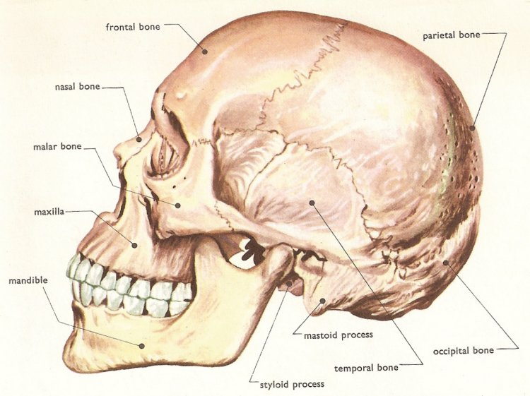
Head Injuries
Fractures
  Cranium
  Base of skull
  Face
Causes – direct or indirect force
  If serious may cause multiple cracking (eggshell fracture)

Slide 5
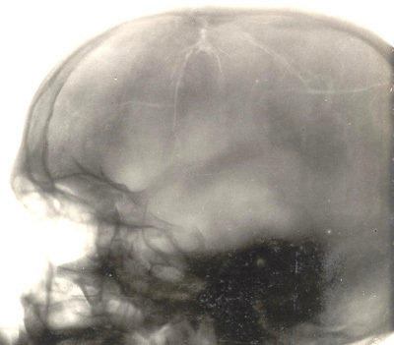
eggshell fracture

Slide 6
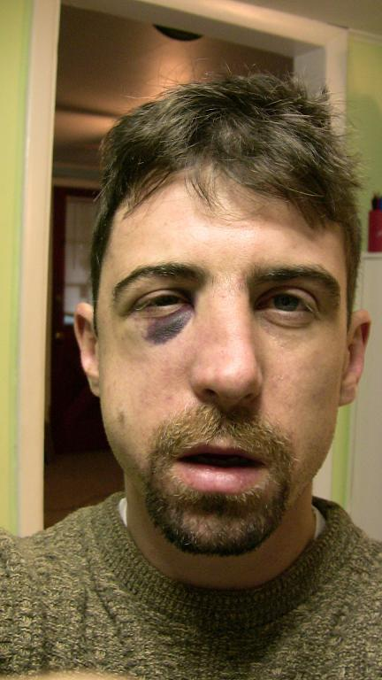
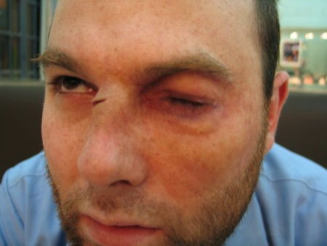
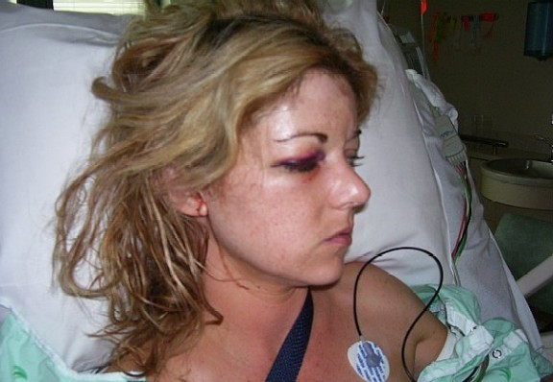
Depressed cheek fractures

Slide 7
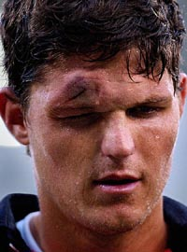
Depressed skull fracture

Slide 8
Head Injuries
Concussion
Concussion is an altered state of consciousness, usually caused by a blow to the head or neck
The casualty may become unconscious but this is often momentary
They may be dazed, confused and complain of headaches and dizziness

Slide 9
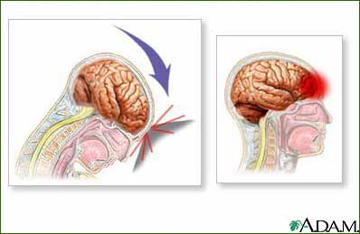

Slide 10
Head Injuries
Although casualty’s with concussion usually recover quickly, there is always the possibility of a serious brain injury!

Slide 11
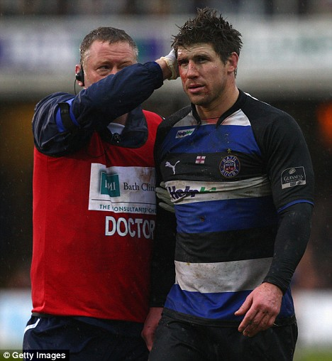
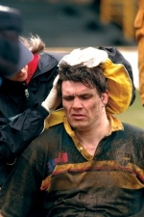
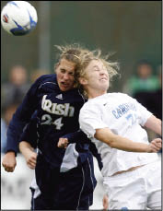
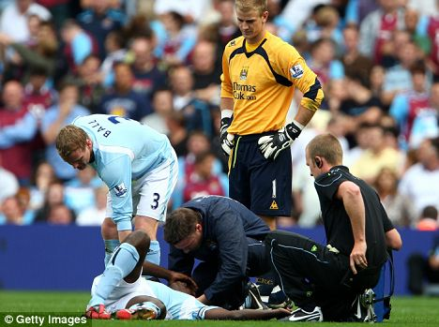

Slide 12
Head Injuries
Compression
Compression is excess pressure on part of the brain
May be caused by:
  a build up of blood inside the skull
  a depressed skull fracture where broken bones put pressure on or directly damage the brain

Slide 13
Head Injuries
If there is bleeding in or on the surface of the brain and it cannot drain away, it builds up and puts pressure on the brain. This is life threatening!

Slide 14

Natasha Richards death March 2009
An autopsy found Natasha Richardson died from bleeding in her skull caused by the fall she took on a ski slope.
Doctors said she might have survived had she received immediate treatment.

Slide 15
Natasha Richards death March 2009
Nearly four hours elapsed between her lethal fall and her admission to a hospital.
She suffered from an epidural hematoma, which causes bleeding between the skull and the brain's covering.

Slide 16
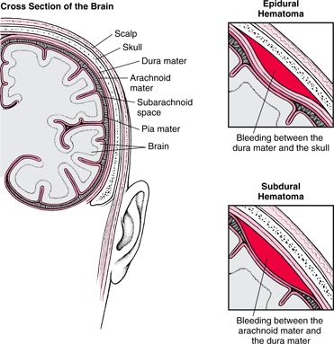
Epidural Hematoma

Slide 17
Epidural Hematoma
Bleeding is often caused by a skull fracture, and it can quickly produce a blood clot that puts pressure on the brain.
That pressure can force the brain downward, pressing on the brain stem that controls breathing and other vital functions.

Slide 18
Epidural Hematoma
Patients with such an injury often feel fine immediately after being hurt because symptoms from the bleeding may take time to emerge.

Slide 19

Assessment of Head Injuries
Often very difficult to accurately assess
Therefore no head injury should be treated lightly

Slide 20
Assessment of Head Injuries
Patients should always be advised to ‘seek medical aid immediately’

Slide 21
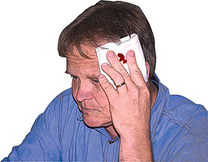
Signs & Symptoms
Headache
Loss of memory
Confusion
Wound to scalp/face
Blurred vision
Nausea or vomiting
Dizziness

Slide 22
Management
Follow DRSABCD
If Conscious
If you suspect neck/spinal injury, immobilise head and neck & ring 000.
If you don’t suspect neck/spinal injury, place in a comfortable position (supine) & assess. Look for any signs and symptoms

Slide 23
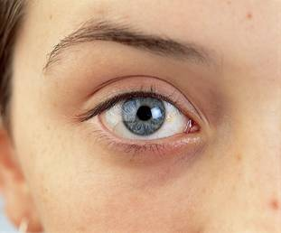
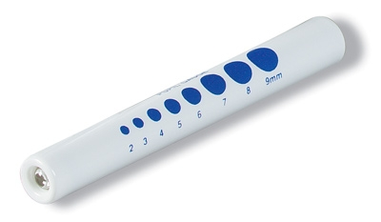
Management
Pupils – check response in both eyes (Pupils Equal and Reacting to Light)
Note - this can be difficult in full sun.

Slide 24
Management
Damage to the nerves (oculomotor) in the brain affect pupil size and reaction and may indicate a rise in pressure in the skull

Slide 25
Management
If one or both pupils are enlarged, and do not react to light, the patient is dangerously ill and needs urgent hospital care.

Slide 26
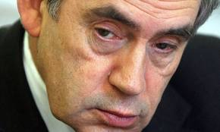
Management
Be aware that 10 to 15% of the population have one pupil 1mm different from the other.
They may also have a glass eye.

Slide 27
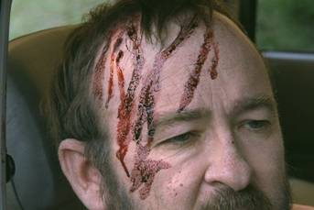
Management
If the patent has a wound, control any bleeding but DO NOT apply direct pressure to skull if you suspect a depressed fracture.

Slide 28
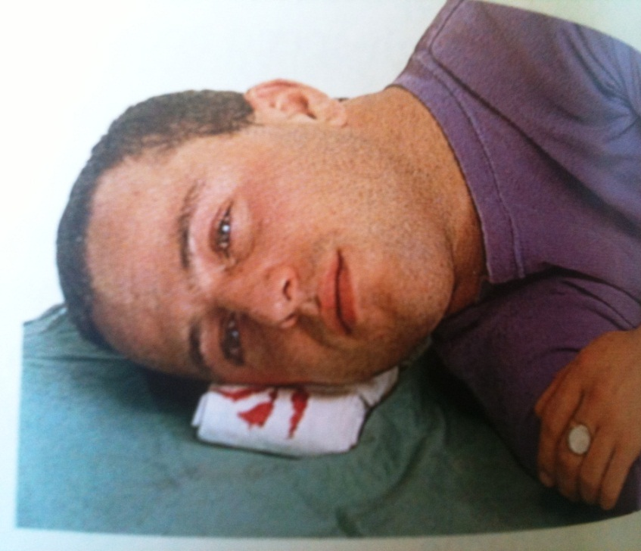
Management
If blood or fluid (CSF) comes from ear, cover with a sterile dressing (lie patient on injured side if possible to allow fluid to drain)

Slide 29
Management
Remember, any advice should include, ‘seek medical aid immediately’

Slide 30
Management
DO NOT give any medications for at least 4 hours.

Slide 31
Management
If you are transporting a patient with a head injury, they must be lying down!

Slide 32
Management
If unconscious (breathing)
DRSABCD - Ring 000
Keep casualty’s airway open
Always suspect a neck or spinal injury
Place in recovery position (log roll - towel), support head/neck in neutral alignment during any movement

Slide 33
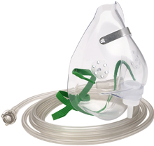
Management
If unconscious
Administer oxygen 8 – 15 lpm.
Continue to monitor breathing closely.

Slide 34
Management
A casualty with a head injury may vomit
Be ready to turn casualty on side, supporting head and neck and clear the airway quickly
You will probably need help to do this

Slide 35
Question
What if a casualty has a head injury and is bleeding from both ears – how are they positioned?

Slide 36
Answer
The patient should be positioned so as to protect their airway and cervical spine. In most cases a patient with a head injury that has resulted in bleeding from the ears will be in an altered conscious state – they will therefore be positioned on their side to protect their airway.

Slide 37
Answer
If the patient is fully conscious then they will be left supine to protect their cervical spine and a cervical collar will be applied.

Slide 38
Answer
The consideration of the bleeding from the ears is a secondary issue – if one ear was bleeding this would be placed downwards – but if both are bleeding it doesn’t matter which side is dependent..

Slide 39
Answer
If the patient is fully conscious leave them supine and the fluid will drain from both, if the patient is in an altered conscious state place them on their side with the ear bleeding the most dependent.

Slide 40
Answer
Bleeding from both ears is suggestive of extreme facial trauma and the patient is likely to be unconscious with considerable airway, breathing and circulation issues that will have to be addressed.

Slide 41
Answer
The bleeding from the ears will be a minor consideration in their overall care as you are unlikely to get out of the primary survey DSRABCD.

Slide 42
Questions

