Slide 1
Chest pain

Slide 2
Angina

Slide 3
What is Angina?
Angina (‘choking pain’) is temporary chest discomfort or pain that typically comes on with exercise or emotional stress.
It usually lasts only a matter of minutes.

Slide 4
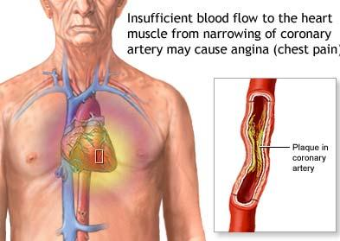
What is Angina?

Slide 5
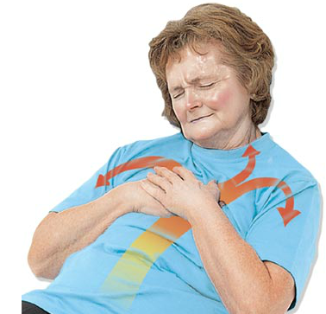
What is Angina?
It can occur when the narrowed coronary arteries are unable to supply the additional oxygen-carrying blood needed when the heart’s activity increases.

Slide 6
Signs & Symptoms
Tight, gripping or squeezing chest pain
Varies from mild to severe
Usually felt in the centre of the chest
May spread to either or both shoulders, the back, neck or jaws or down the arm and can even be felt in the hands
Sometimes it is experienced in these other parts of the body without being felt in the chest.
Sometimes angina is experienced as shortness of breath, rather than pain

Slide 7
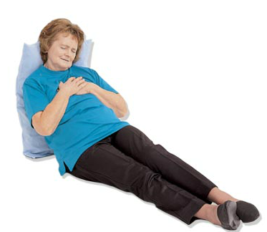
Management
Ask patient to stop what they are doing and rest in the most comfortable position
Ask the patient if they have angina medication with them

Slide 8

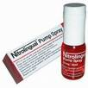
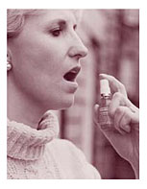
Management
Help them take their medication either tablets under the tongue or inside the cheek or Nitrolingual Spray
If no improvement after 5 minutes, give another dose

Slide 9
Management
If no improvement after 10 minutes, call 000 for an ambulance and monitor signs and be prepared to give CPR

Slide 10

Management
Give conscious patient 300 mg (one tablet) of aspirin in water
DO NOT give Aspirin if:
The are allergic to aspirin
They are on anticoagulants (blood thinning) medication (e.g. warfarin)
The doctor has warned them against taking aspirin

Slide 11
Heart Attack

Slide 12
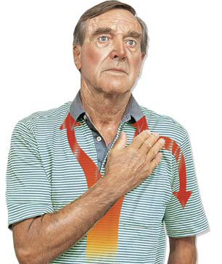
What is a Heart Attack?
A heart attack occurs when there is a sudden complete blockage of an artery.

Slide 13
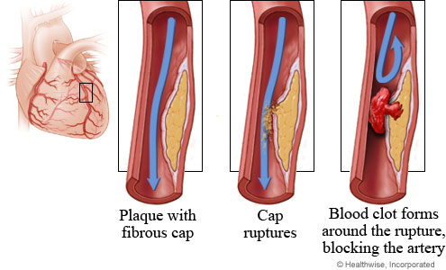
What happens?
Over many years an area of fatty tissue (thickened with cholesterol) builds up on the artery wall forming a cap.

Slide 14
What is a Heart Attack?
One day the cap ruptures.

Slide 15
What is a Heart Attack?
A blood clot will quickly form around the rupture blocking the artery.

Slide 16
Myocardial Infarction
A heart attack is also referred to by health professionals as a Myocardial infarction (MI)
The resulting ischemia (restriction in blood supply) and oxygen shortage, causes damage or death (infarction) of heart muscle tissue (myocardium).

Slide 17
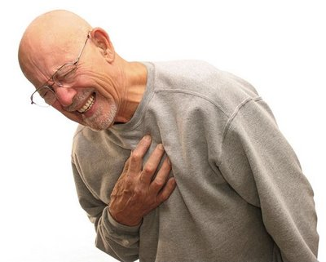
Important
Heart attack is a life-threatening emergency!
The first aider must act quickly and call 000 for an ambulance immediately!

Slide 18
Why must we act quickly?
Damaged heart muscle may initiate an uncontrolled disorganised rhythm that may stop the heart beating effectively.
Ventricular fibrillation!
This is the most common cause of cardiac arrest.
When it occurs, cardiac arrest may follow within minutes of the first symptoms of a heart attack.

Slide 19
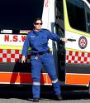

Why must we act quickly?
Paramedics and Doctors working in emergency departments use clot dissolving drugs and other treatments which are used to reduce the amount of permanent damage to the heart muscle.

Slide 20
Why must we act quickly?
These must be given soon after a heart attack occurs to be effective.

Slide 21
Important
If the patient has chest pain similar to Angina, but it is not relieved by medication and rest, the first aider should manage the patient as if they are having a heart attack!

Slide 22
Signs & Symptoms
Chest Pain
in the centre of the chest
may come on suddenly or sometimes may start slowly and may feel like tightness, pressure, heaviness, fullness, or squeezing

Slide 23
Signs & Symptoms
Chest Pain
may be severe, moderate or mild
May spread to the neck and jaw, throat, shoulders, back, arms and into the wrist and hands

Slide 24

Signs & Symptoms
Other signs & symptoms
Some do not get any chest discomfort — only discomfort in parts of the upper body
May have a ‘choking’ feeling in the throat

Slide 25
Signs & Symptoms
Other signs & symptoms
Arms may feel ‘heavy’ and useless
Sweating, shortness of breath
Dizziness or feeling light-headed
Sick feeling or actual vomiting

Slide 26
Signs & Symptoms
Often women experience fewer typical symptoms than men, most commonly shortness of breath, weakness, a feeling of indigestion, and fatigue
Approximately one quarter of all myocardial infarctions are silent, without chest pain or other symptoms

Slide 27
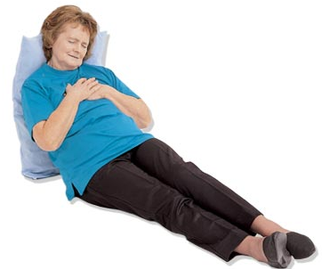
Management
Ask patient to stop what they are doing and rest
Help the patient to sit or lie down whichever is more comfortable and provide reassurance.

Slide 28
Management
Ask them to describe their symptom.
Loosen tight clothing.
Oxygen therapy 8‐15 LPM via Face Mask
If any symptoms are severe, get worse quickly or last 10 minutes call 000 for an ambulance

Slide 29
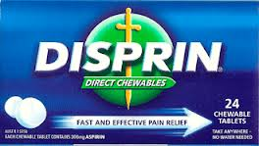
Management
Give conscious patient 300 mg (one tablet) of aspirin (remember restrictions)
Monitor vital signs and be prepared to give CPR

Slide 30
Questions

Slide 31
BREAK

Slide 32
Scenario
You are on duty at a public event when a member of the public asks if you can come and have a look at their elderly father who is not feeling well. When you arrive he is sweaty with an obvious shortness of breath and complaining of dizziness and feeling sick in the stomach. He does not have a history of heart problems.

Slide 33
Management
Help the patient to sit or lie down whichever is more comfortable and provide reassurance.
Call 000.
Ask them to describe their symptoms.
Loosen tight clothing

Slide 34
Management
Oxygen therapy 8‐15 LPM via Face Mask
Give 300 mg (one tablet) of aspirin (remember restrictions)
Complete 2 sets of observations
Completed OB12 in total and Handover

Slide 35
Scenario
You are on duty at a public event when a member of the public presents to you with discomfort in the chest. They have been experiencing it for over an hour now and feel it is perhaps indigestion. They describe it as a tight squeezing feeling. You note they are pale, clammy and short of breath.

Slide 36
Management
Help the patient to sit or lie down whichever is more comfortable and provide reassurance.
Call 000.
Ask them to describe their symptoms.
Loosen tight clothing

Slide 37
Management
Oxygen therapy 8‐15 LPM via Face Mask
Give 300 mg (one tablet) of aspirin (remember restrictions)
Complete 2 sets of observations
Completed OB12 in total and Handover

Slide 38
Questions

